Slide 1

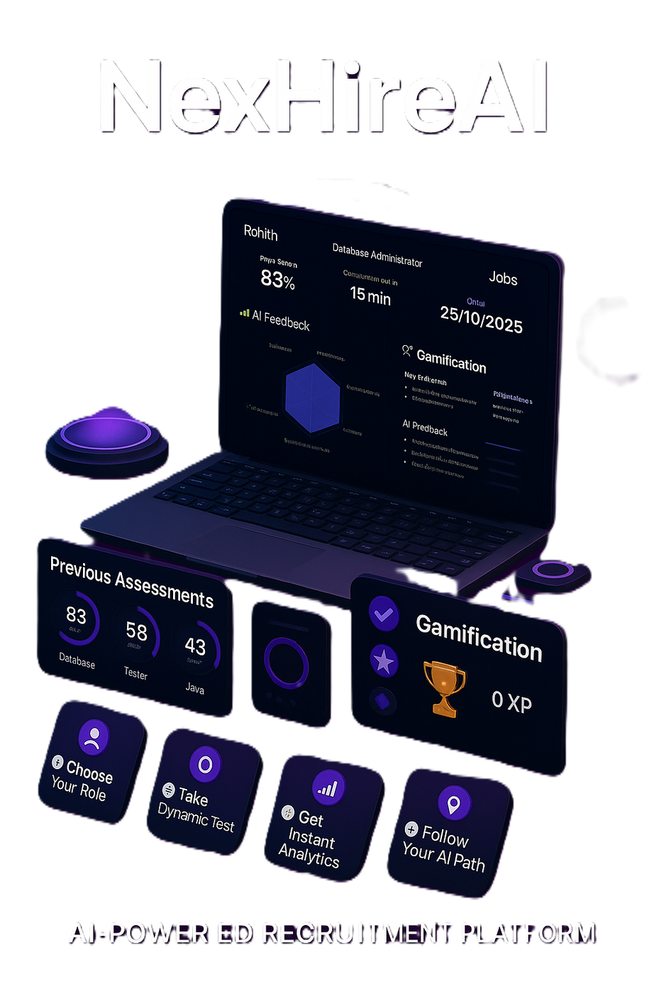
NEXHIREAI : REVOLTIONIZING SKILL ASSESSMENT AND CAREER GROWTH
Team Number - 129
Mentor - Mr. Bediga Sharan (Assistant Professor)
2203A52157 - Macharla Rohith
2203A52173 - Sanga Akhilananda Teja
2203A52174 - Satkuri kailash
2203A52156 - Kunduru Sai Sruthi​

Slide 2

Problem statement
The existing system of recruitment is very time consuming, discriminatory, and ineffective. Hundreds of resumes have to be sifted through manually by the recruiters and it is hard to assess the real abilities of the candidate. Talented people with non-traditional background find it difficult to demonstrate their talents because there is no standardized means of skill validation. Also, it does not offer any tools that can provide a real-time skill analytics or customized career assessment insights. Consequently, the recruitment process is still slow, subjective and not skills-based resulting in poor decisions and lost talent opportunities.

Slide 3
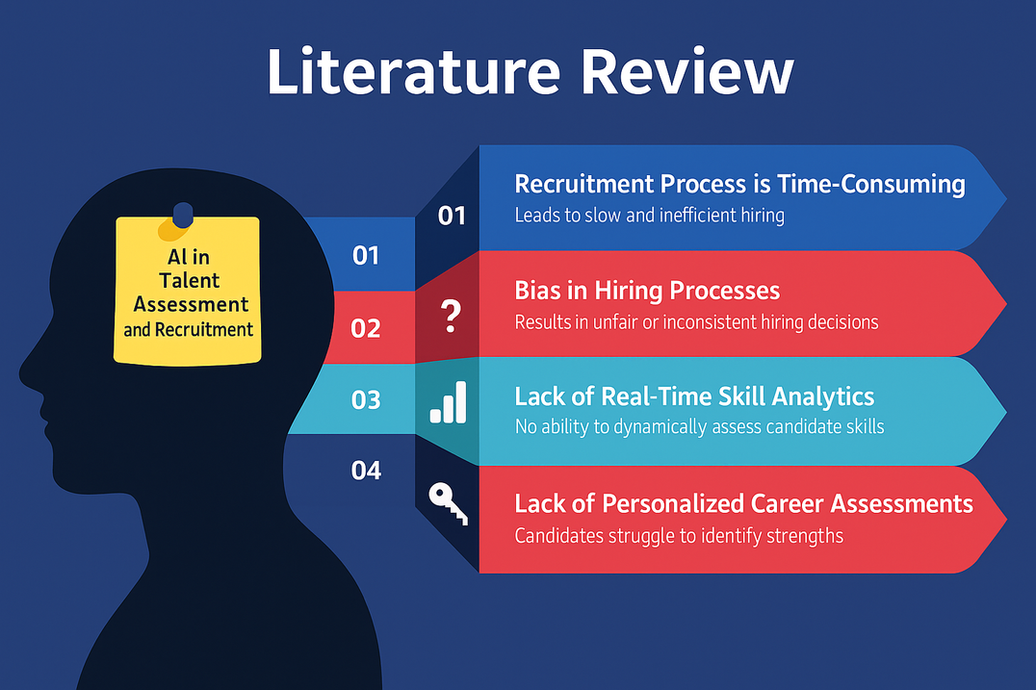
Literature Review
Manual resume screening slows hiring.
Current assessment platforms are static and generic.
No real-time skill analytics or personalized insights.
Recruiters lack automated tools for fair evaluation.
Gap: No unified AI pipeline for assessment + scoring + recommendation.

Slide 4

Objectives of the Problem
Generate role-based adaptive assessments using AI.
Score coding/MCQs/subjective answers transparently.
Provide dashboards & personalized career insights.
Support recruiters with analytics and role-fit predictions.
Maintain fairness, data privacy, and ethical AI use.

Slide 5
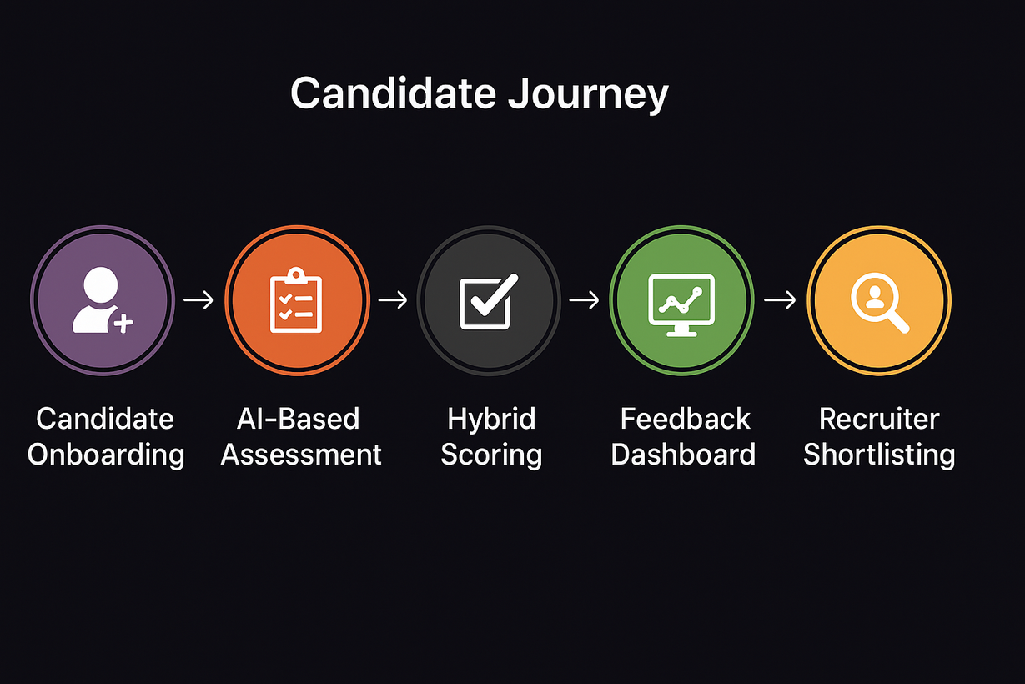
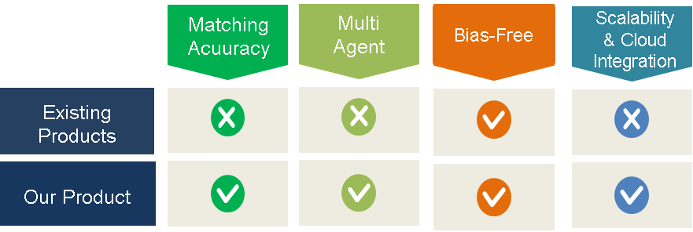
Overview of the Solution Pipeline
NexHireAI is an AI-powered recruitment platform that automates candidate screening and dynamically evaluates skills using adaptive assessments and AI-based interviews. It delivers instant scoring and actionable insights, enabling faster, fair, and data-driven hiring decisions.
Uniqueness

Slide 6

Candidate Onboarding
Candidate signs up and logs into NexHireAI using secure authentication.
Candidate selects the desired role-based assessment from the dashboard.
Candidate Journey Timeline
Skill Assessment Selection & Generation
Candidate attempts the assessment and submits responses within the test interface.
Assessment Execution
A visual representation of the candidate's journey through NexHireAI.
Automated Evaluation & Feedback
System evaluates responses using hybrid scoring and provides instant feedback.

Slide 7
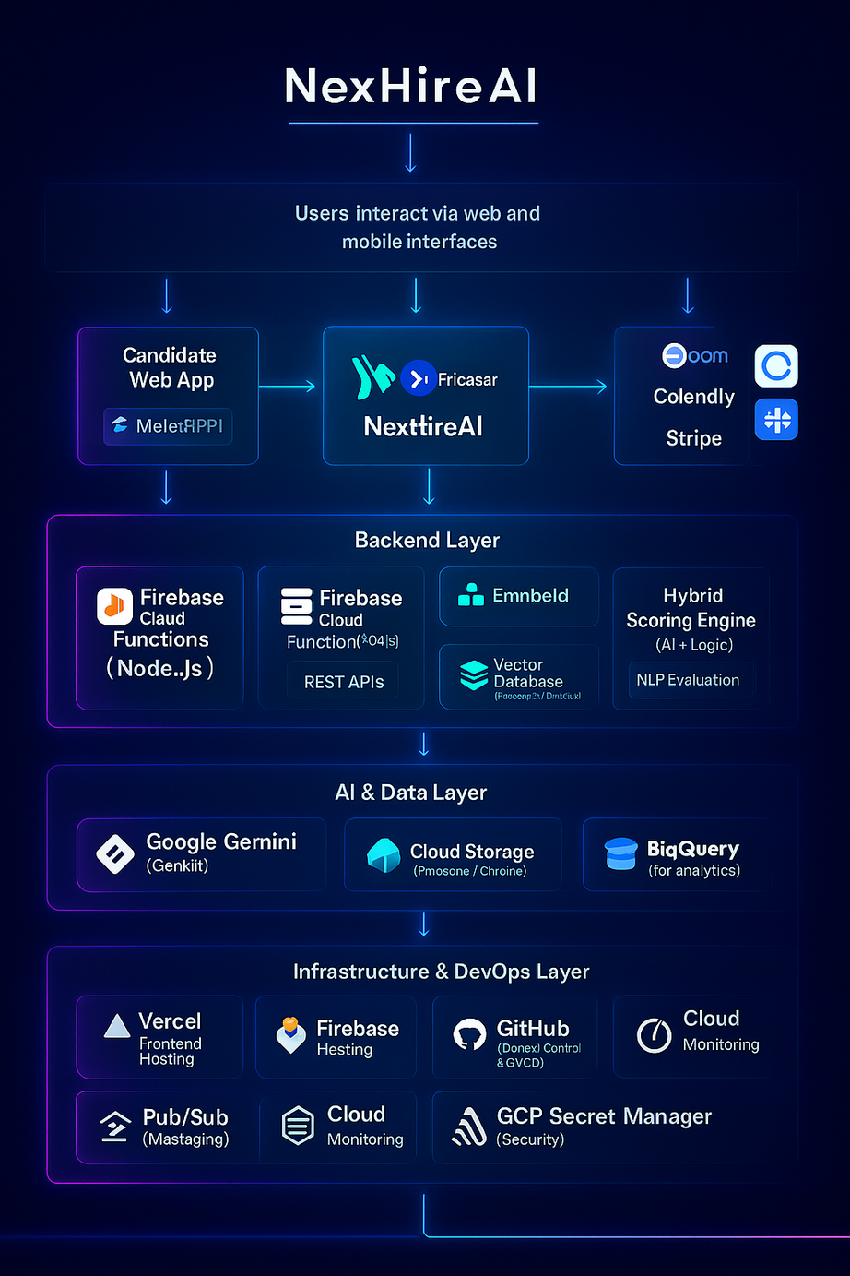
Tech Stack
Frontend
Framework: Next.js 14 (React + TypeScript)
Styling: Tailwind CSS, Framer Motion (animations)
UI Components: Shadcn/UI, Lucide Icons
State Management: Zustand
Charts & Visuals: Recharts
Backend
API / Serverless Functions: Firebase Cloud Functions (Node.js runtime)
Authentication: Firebase Authentication (Email/Google OAuth)
Database / Storage: Firebase Firestore (NoSQL database)
Development Tools
IDE: Visual Studio Code
Package Manager: npm / yarn
Version Control: Git
Browser Tools: Chrome DevTools, Firebase Emulator
AI & Machine Learning Layer
LLM / AI Model: Google Gemini (Genkit)
AI Capabilities: Dynamic question generation, semantic evaluation, scoring, feedback generation
NLP & Scoring Techniques: TF-IDF / Embeddings / Hybrid evaluation logic
Database
• Primary: Firebase

Slide 8
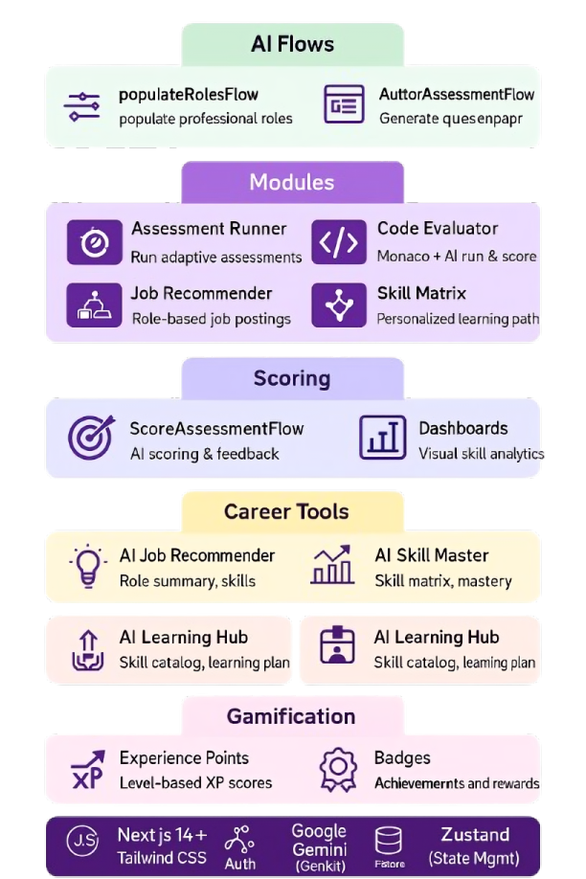
Detailed Solution
1
AI-Generated Role-Based Assessments:
3
Real-Time Dashboards & Skill Analytics
The system dynamically creates assessments using Genkit + Google Gemini based on predefined professional roles.
Users receive visual dashboards showing progress, performance graphs, and personalized insights from AI.
2
Automated Scoring & Personalized Feedback
4
Gamified Career Growth Tools
Submissions (MCQ, coding, subjective) are evaluated using an AI-based scoring module, and learning recommendations are stored for the user.
The platform offers job recommendations, learning paths, XP points, and badges to improve engagement and skill enhancement.

Slide 9

HOW NEXHIREAI STANDS OUT
NexHireAI creates assessments on the fly with AI (Genkit + Gemini) as opposed to using fixed question banks so that each applicant receives a unique assessment.
It more-or-less automatically scores MCQs, coding, and descriptive responses using AI and generates real-time feedback, dashboards, skill knowledge, and recommendations on learning.
It combines assessment, analytics, gamification, and career guidance within a single platform providing a fully end-to-end talent evaluation system, a feature that traditional hiring tools do not have.

Slide 10
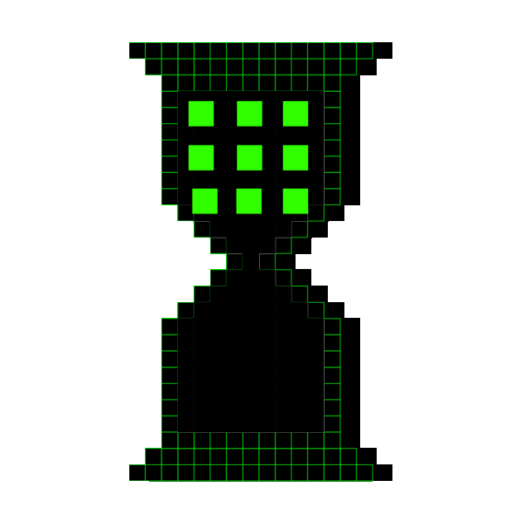
FUTURE ENHANCEMENTS
Voice-to-Text AI for dynamic interviews
Recruiter analytics dashboard for insights
Blockchain Verification – Ensure secure and transparent credential validation for candidates.
Predictive analytics for employee success evaluation

Slide 11

RISKS AND CHALLENGES
Bias in training data can lead to unfair decisions
Data privacy concerns regarding candidate information
Scalability challenges for handling large datasets efficiently
API dependency risks that may cause downtime issues
Addressing potential bias in AI-driven assessments

Slide 12

CONCLUSION
Overview of NexHireAI's Features and Benefits
- AI-driven recruitment platform enabling automation, fairness, and data-backed hiring decisions.
Challenges in Traditional Recruitment Methods
- Manual processes, human bias, and lack of real-time skill evaluation.
Proposed Automated Recruitment Pipeline Steps
- Candidate Onboarding → AI Assessment → Hybrid Scoring → Feedback → Shortlisting.
Future Enhancements to Improve Performance
- AI interviews, skill recommendations, blockchain validation, and mobile app support.
Industry Potential and Scalability of the Solution
- Highly adaptable across industries with cloud-based architecture and AI scalability.

Slide 13
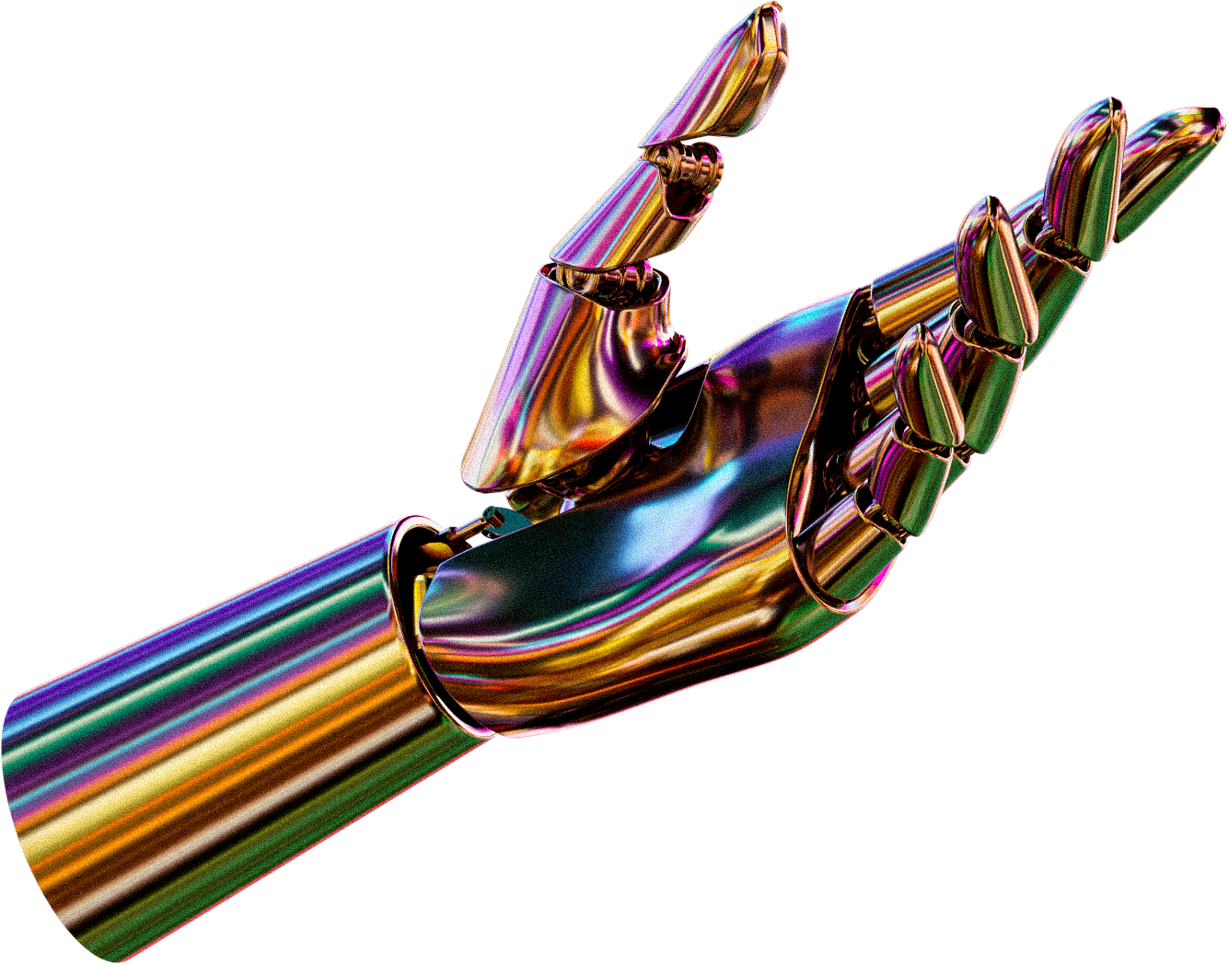
THANK YOU

